Slide 1

Capstone Project
Opening a New Restaurant in Indore, India
Sakshi Mahajan
16 Jan 2020

Slide 2
Business Problem
Location of the Restaurant is one of the most important decision that will determine whether the place will be a success or a failure.
Objective: To analyse and select the best location in Indore city of India to open a New Restaurant.
Business Question:
In the Indore city ,if a property developer or a Restaurant owner is looking to open a Restaurant or its franchise where would you recommend that they open it?

Slide 3
Data
Data Required:
List of Neighbourhoods in Indore.
Latitude and longitude coordinates of the neighbourhoods
Venue data, particularly data related to Restaurants
Sources of data:
Wikipedia page for neighbourhoods
(https://en.wikipedia.org/wiki/Category:Neighbourhoods_in_Indore)
Geocoder package for latitude and longitude coordinates.
Foursquare API for venue data.

Slide 4
Methodology
Web scraping Wikipedia Page for neighbourhoods list.
Get latitude and longitude coordinates using Geocoder.
Use Foursquare API to get venue data
Group data by neighbourhood and taking the mean of the frequency occurrence of each venue category
Filter venue category by Restaurant
Perform clustering on the data by using k-means clustering
Visualize the cluster in a map using Folium.

Slide 5
Results
• Cluster 0: Neighborhoods with moderate number of Restaurants
• Cluster 1: Neighborhoods with low number to no existence of Restaurants
• Cluster 2: Neighborhoods with high concentration of Restaurants.
The results of the clustering are visualized in the map below with

Slide 6
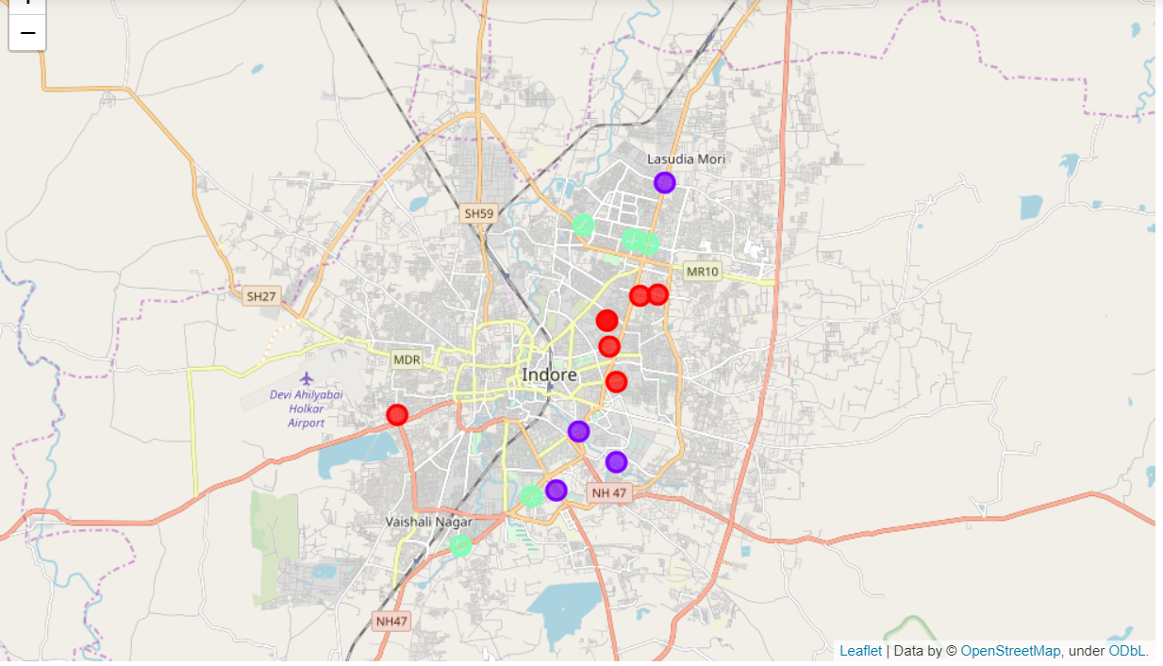
cluster 0 in red color,
cluster 1 in purple color,
cluster 2 in mint green color.

Slide 7
Recommendation
Open new Restaurants in neighborhoods in cluster 1 with little to no competition
Property developers with unique selling propositions to stand out from the competition can also open new Restaurant in neighborhoods in cluster 0 with moderate competition
Lastly, property developers are advised to avoid neighborhoods in cluster 2 which already have high concentration of Restaurant and suffering from intense competition.

Slide 8
Conclusion
Answer to Business Question:
The neighbourhoods in cluster1 are the preferred locations to open a new Restaurant.
The findings of this project will help the relevant stakeholders to capitalize on the opportunities on high potential locations while avoiding overcrowded areas in their decisions to open a new Restaurant.

